Slide 1

Hype vs Love:
The Ultimate Anime Analysis Report
By Linda Wachira

Slide 2
Problem Statement
Anime is one of the fastest-growing entertainment industries worldwide, with millions of titles competing for viewership and fan recognition. While platforms like MyAnimeList (MAL) provide rankings such as Overall, Popularity, and Favourability, it is unclear how these rankings relate to one another or to the ratings that fans assign.
Understanding these relationships provides insights into audience behavior, the balance between quality and popularity, and the dynamics of anime rankings.

Slide 3
Project Objective
General Objective
To analyze and visualize the relationship between anime rankings (overall, popularity, and favourability) and their ratings, in order to understand audience preferences and trends on MyAnimeList (MAL).
Specific Objective
To determine whether the most popular anime are also the most highly rated.
To examine the relationship between fan favourability rankings and anime ratings.
To assess whether overall rankings align more closely with popularity or favourability.
To identify anime that perform strongly in one ranking category but not in others, highlighting differences in audience perception.

Slide 4
Research Questions
Do higher popularity rankings correspond to higher anime ratings?
How does fan favourability ranking relate to anime ratings?
Do popularity and favourability rankings correlate with each other?
How do individual anime overall ranks compare against popularity and favourability ranks?

Slide 5
Data Collection, Preprocessing & Visualization
The data used in this project was scraped from My Anime List website. Find code here.
Data preprocessing was done in MySQL. Find code here.
Data Visualization was done on Power BI. Find file here.

Slide 6
Analysis & Insights

Slide 7
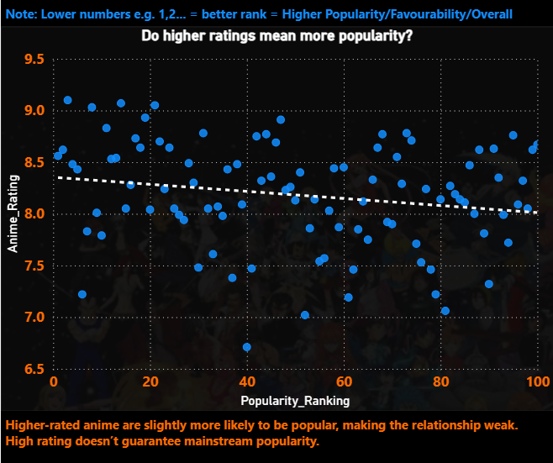
Do higher popularity rankings correspond to higher anime ratings?
Higher-rated anime are slightly more likely to be popular, making the relationship weak. High rating doesn’t guarantee mainstream popularity.

Slide 8
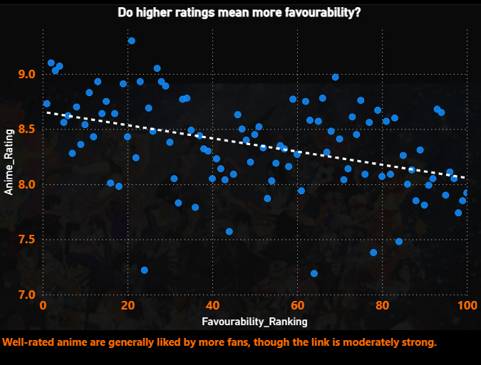
2. How does fan favourability ranking relate to anime ratings?
Well-rated anime are generally liked more by fans, though the link is moderately strong

Slide 9
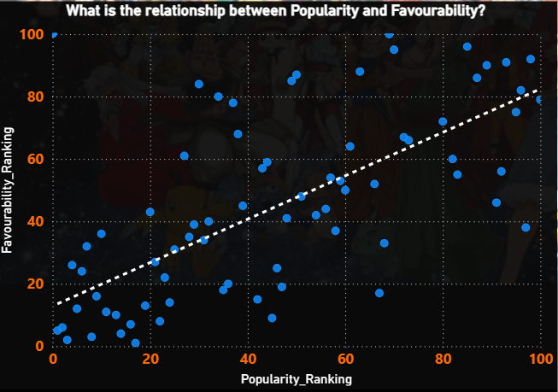
3. Do popularity and favourability rankings correlate with each other?
Popular anime tend to also be favourably ranked, showing a strong positive relationship

Slide 10
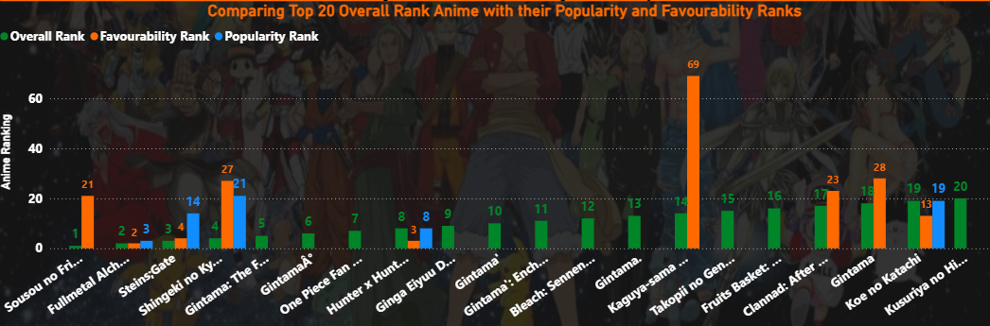
4. How do individual anime overall ranks compare against popularity and favourability ranks?

Slide 11
Cont.
Only a select few of anime appear in all three categories, with Fullmetal Alchemist: Brotherhood(FMAB) being in top 3 for all three categories.
A notable mention would be Sousou no Frieren that ranks number 1 overall but is number 21 most favourite and not in top 100 most popular anime.
This begs the question: What factors contribute to an anime achieving the #1 overall rank even if it is not highly popular or favourable compared to others?

Slide 12
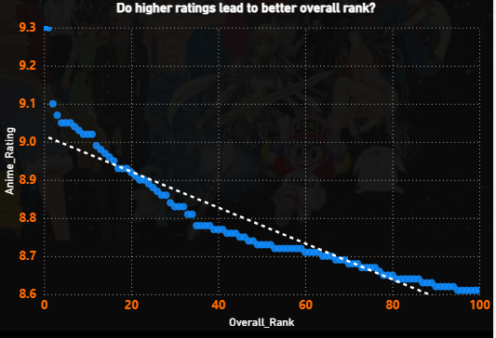
5. Do higher ratings lead to better overall ranks?
Higher-rated anime consistently achieve better overall ranking, which is the case for Sousou no Frieren, with a stunning rating of 9.3.
It is followed by FMAB with a 9.1, which we saw earlier appeared in top 3 in both most popular and most favourite.

Slide 13
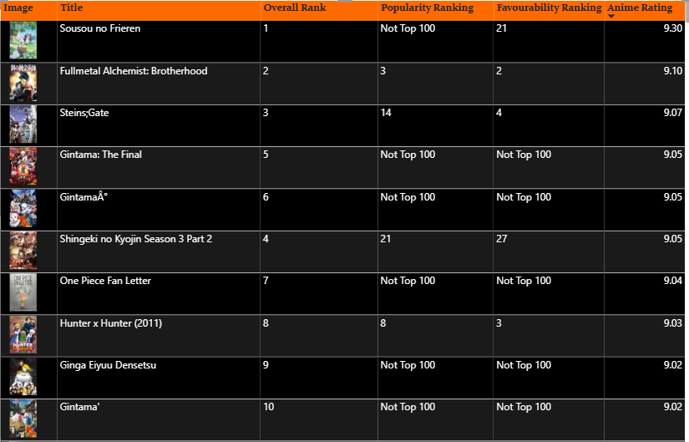
6. Do highly rated anime by default mean most popular/most favourite anime?
The table displays top 10 highest rated anime according to MAL, which also means top 10 overall anime.
Majority of them do not appear in top 100 most favourite anime or most popular anime despite high ratings.
This means that a higher rating/overall ranking does not always mean most popular/most loved.

Slide 14
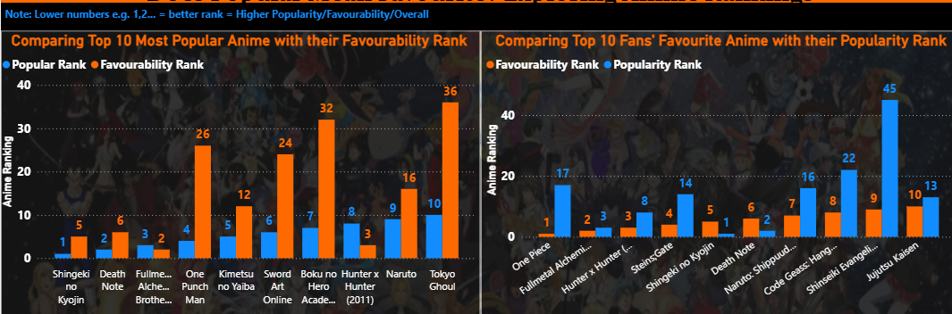
How much overlap is there between the Top 10 Most Popular and the Top 10 Most Favourite lists

Slide 15
Cont’
Chart 1(left) compares top 10 most popular anime with their favourability ranking while chart 2 does the vice versa.
In chart 1 it appears that most popular does not always mean most favourite, with anime like One Punch Man, Sword Art Online, Boku no Hero Academia and Tokyo Ghoul dragging the favourability ranking by far.
Chart 2 on the other hand is slightly different. The most favourite anime moderately correspond with their popular ranks, with one exception that is Shinseiki Evangelion.
Although there shows to be a big gap in the #1 most favourite anime, One Piece that turns up in #17 most popular. This means that in some cases Fans’ favourite may not be as popular as one may think.

Slide 16
Recommendation
For Anime Platforms
Based on the analysis, streaming platforms should not rely solely on popularity rankings when recommending anime to viewers. Titles such as Sousou no Frieren, which rank highly in ratings and favourability but fall short in popularity, demonstrate the value of promoting lesser-known but high-quality anime.

Slide 17
Recommendation Cont’
For Anime Viewers
High-rated and highly favoured anime may not always appear in the “Top 100 Popular,” so checking favourability rankings can uncover hidden gems.
Viewers seeking critically acclaimed shows can rely on high ratings and overall rank, while those looking for community favourites should also check favourability metrics.
PS: Since Fullmetal Alchemist: Brotherhood appears in top three in all three categories(overall, most popular, most favourite) and also has a very high rating based on the analysis, this researcher recommends watching this show as it ticks the boxes.

Slide 18
Recommendation Cont’
For Data Perspective (future work)
Expand dataset with runtime, genres, and release years → Adding these dimensions could reveal why some anime succeed in favourability but not popularity.
Trend analysis over time → Checking if correlations change by year/season would give more dynamic insights.

